Slide 1
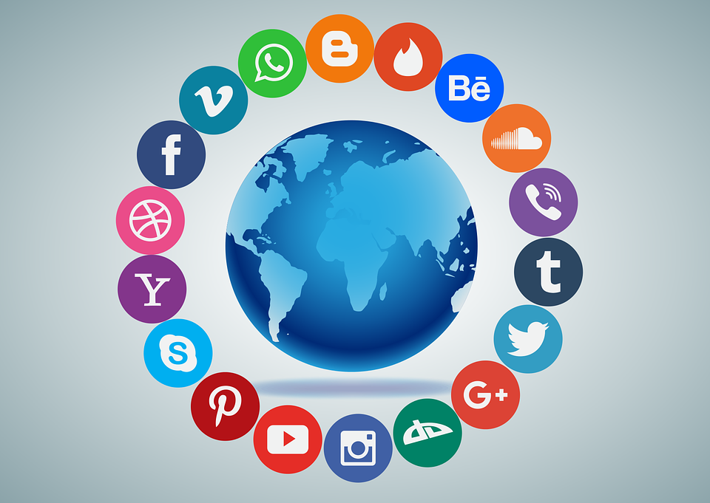

Social media for business by
Ashiat Adeogun
Communication Consultant

Slide 2
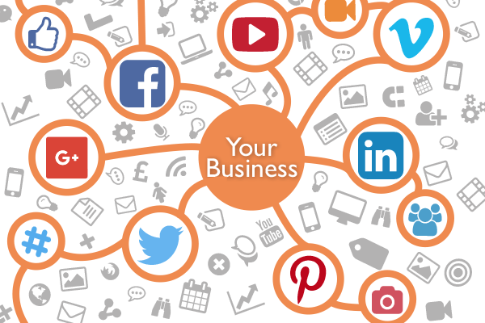
outline
What is Social Media Ecosystem?
Examples of Social Media platforms
What is the Social Media Marketing?
​What are the impacts of social media on business capabilities
Benefits of social media for business
Conclusions and Recommendations
Sources

Slide 3
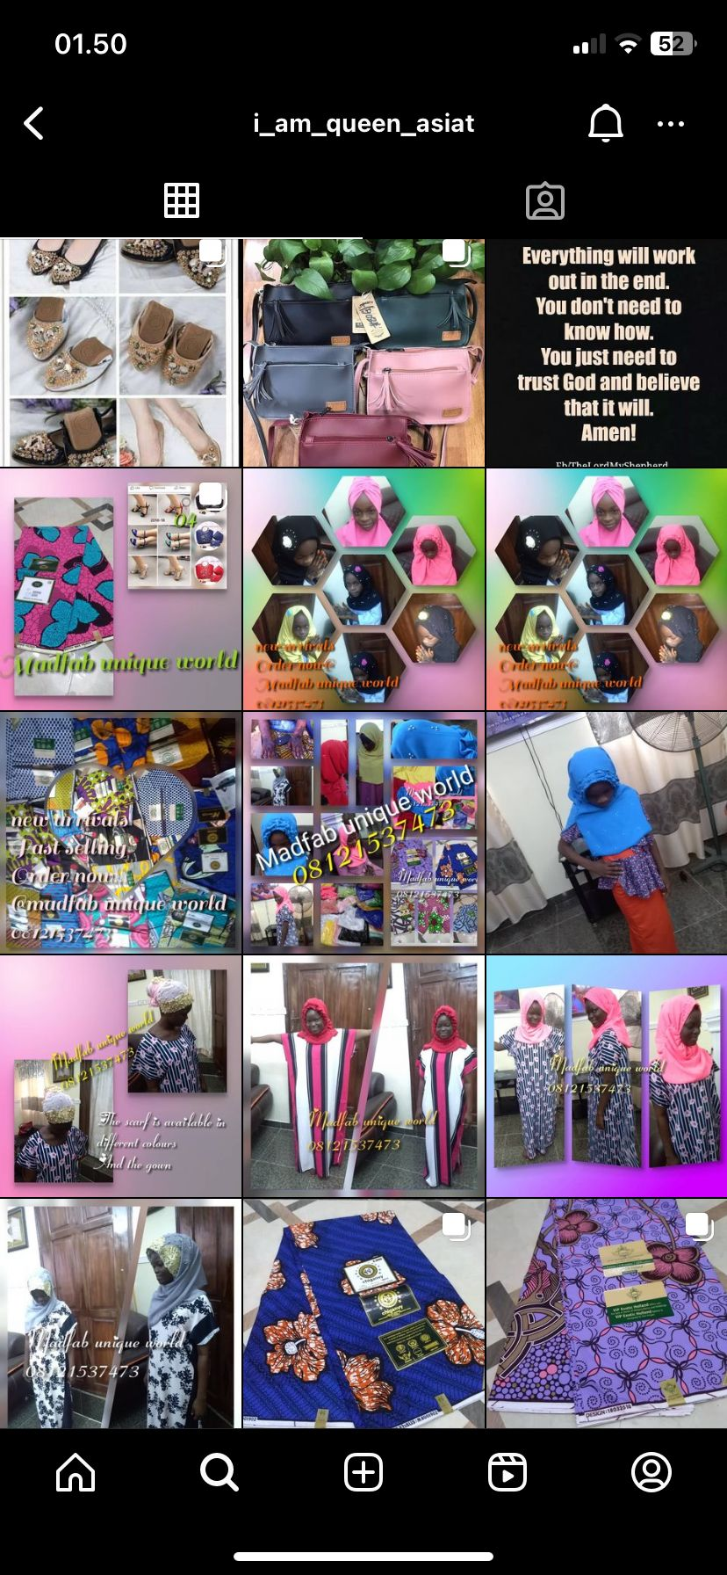

In 2017

Slide 4
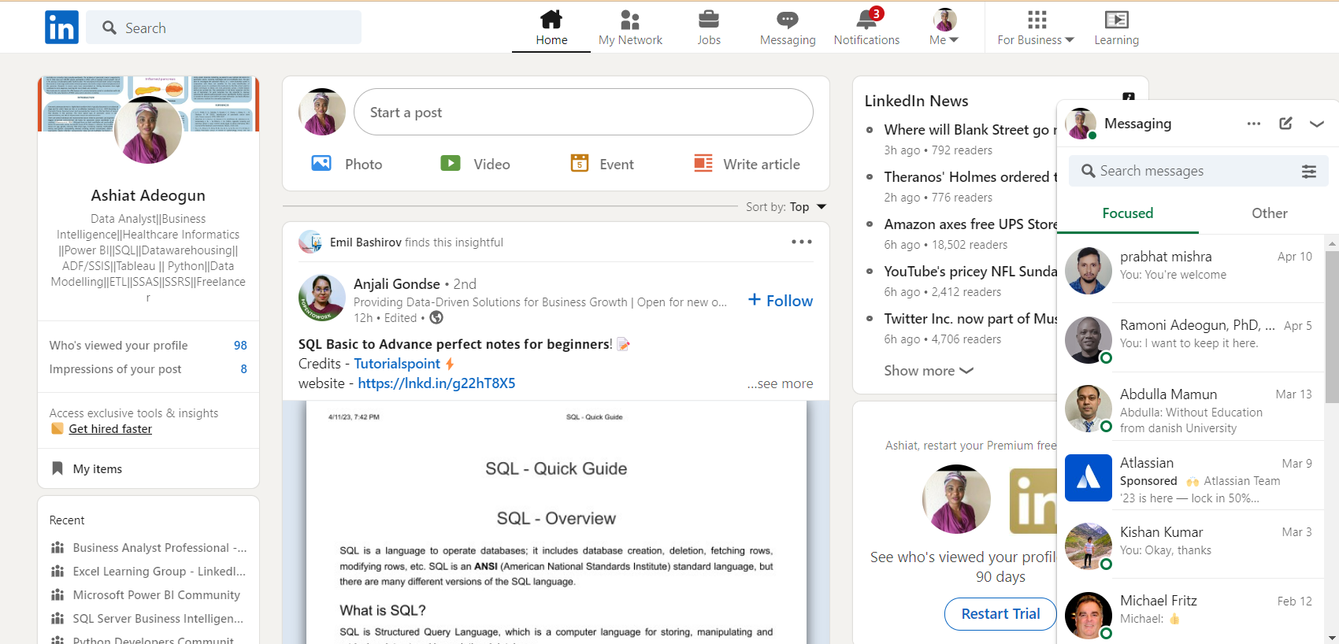
In 2021

Slide 5

What is social media marketing?
Social media marketing (SMM) is a type of digital marketing in which a product, service, or brand is promoted via social media platforms and tools.
SMM may help businesses and organizations access a wider audience, raise brand awareness, generate leads, drive visitors to their websites, and ultimately increase sales and revenue.
It comprises various tasks, such as creating and posting content, connecting with followers and customers, implementing social media marketing, and tracking and analyzing performance indicators

Slide 6
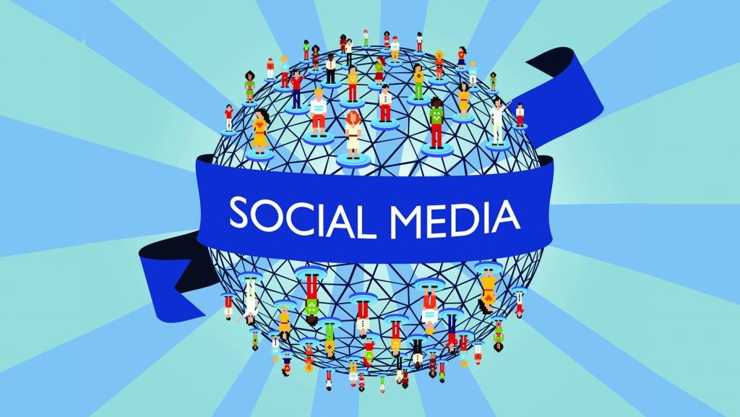
What is social media ecosystem?
The social media ecosystem refers to the collection of platforms, tools, and technologies that enable users to create, share, and interact with content and each other through social networks.

Slide 7
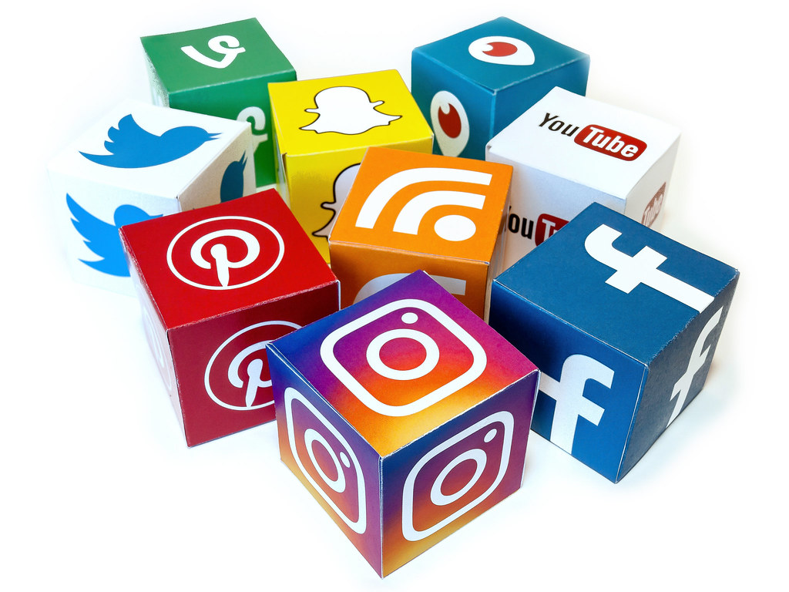
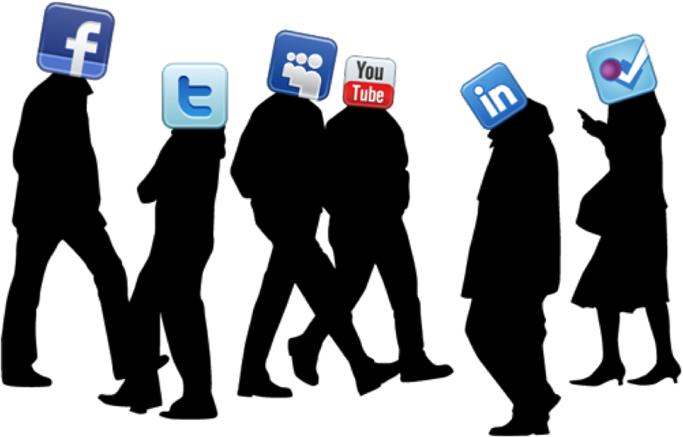
Today’s social media ecosystem has two key components:
THE SOCIAL MEDIA PLATFORMS
THE USERS

Slide 8





WHAT ARE THE SOCIAL MEDIA PLATFORMS
These are the common examples of social media platforms?
Facebook
Instagram
TikTok
LinkedIn
Youtube

Slide 9

WHO ARE SOCIAL MEDIA users?
Social media platforms have diverse users, including
individuals,
businesses,
non-profit organizations, and
public figures.
From a business perspective, users use social media platforms to
reach their target audience,
build brand awareness,
engage with customers, and
drive sales.

Slide 10
What are the IMPACTs of social media on business capabilities
Collaboration and communication
Customer Relationship
There are six functional building blocks of social media impact on business capabilities.
Knowledge Management
Innovation
Rapid application development
Training

Slide 11
BENEFITS OF social media FOR Business
By utilizing social media, businesses can strengthen customer interactions, drive product and service innovation, and recruit new talent. Social media provides a low-cost, easily accessible platform for developing a personal brand and communicating a business's personality within and outside the firm.
It also allows immediate and simultaneous engagement with colleagues, employees, customers, and the public.
It enables businesses to leverage relationships, exhibits dedication to a cause, and highlights a capacity for reflection. Additionally, social media provides an opportunity to learn from real-time information and unfiltered comments.

Slide 12
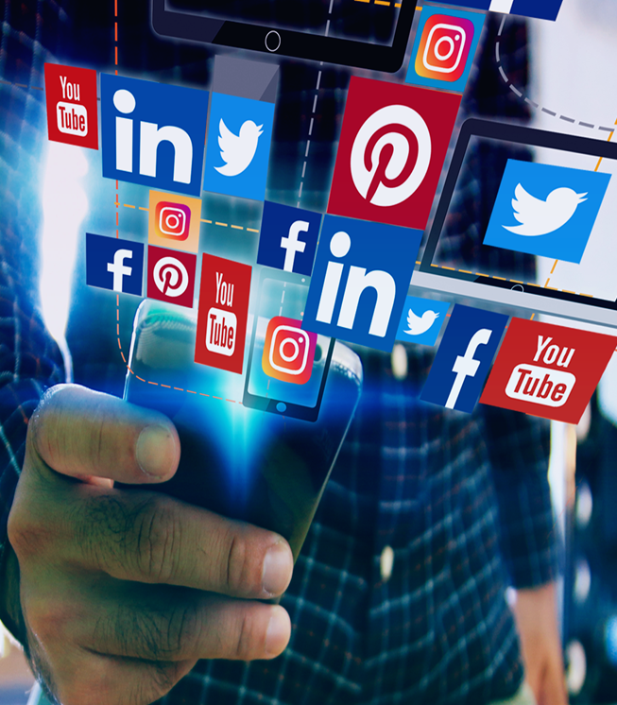
CONCLUSIONs AND RECOMMENDATIONs
Social media has become essential for businesses to communicate with customers, raise brand awareness, and enhance sales.
The rise of social media platforms has influenced consumer behavior and marketing practices.
Based on the findings, businesses may consider adopting social media as a marketing strategy.
Social media should be used to promote, develop, maintain, and strengthen social and professional ties with stakeholders.
Selecting the right platform or platforms compatible with their target audience and business objectives is essential.
To maintain success, it is crucial to keep up with changes in the world of social media and alter methods accordingly.

Slide 13
You don’t need a corporation or a marketing company to brand you now: you can do it yourself. You can establish who you are with a social media following.
“
”
Ray Allen

Slide 14
sources
Appel, G., Grewal, L., Hadi, R., & Stephen, A. T. (2020). The future of social media in marketing. Journal of the Academy of Marketing Science, 48(1), 79-95.
Hruska, J., & Maresova, P. (2020). Use of social media platforms among adults in the united states—behavior on social media. Societies, 10(1), 27.
Irbo, M. M., & Mohammed, A. A. (2020). Social media, business capabilities and performance: A review of literature. African Journal of Business Management, 14(9), 271-277.
Joseph, O. P., Tulung, J. E., & Wangke, S. (2020). Impact of social media marketing towards business performance of MSMES in manado during COVID-19 pandemic. Jurnal EMBA: Jurnal Riset Ekonomi, Manajemen, Bisnis Dan Akuntansi, 8(4)

Slide 15
THANK YOU!
QUESTIONS AND SUGGESTIONS ARE WELCOME!

